Slide 1
Denver Crime DATA Improve Query Performance Using indexing and partitioning
Deepa Ravichandran(700687747)
Medhasree Nangunoori(700688970)
Krishna Poojitha Vaka(700691512)
Rohini mannepalli(700658261)

Slide 2
Performance Improvisation
Applied clustered and non clustered Indexes, also performed the performance evaluation with and without indexes.
As a part of performance tuning, Partitioning is also implemented.
Successful implementation of scenarios using Indexing and Partitioning.

Slide 3
SOFTWARES
SQL Server 2017 Express Edition.
SQL Server Management Studio.

Slide 4
DATA INFORMATION
The Denver Crime Data has the following csv files.
Crime.csv: This table has a total of 458k rows and 19 columns containing the details of all the Crime or incident that occurred. Incident Id, offense Id, Offense code, Offense Code extension,Offense type Id,Offense ,first occurrence date, last occurrence date, category Id, reported date, Incident address,Geo _lon, Geo_lat, Geo_X , Geo_Y, district id, precinct id,neighborhood id,IsCrime and IsTraffic are the list of columns.
Offense_codes.csv: This table has a total of 299 rows and 8 columns containing the detailed information about the offense. It contains Information like Offense_Code, Offense_code_extension,offense_type_id,Offense_type_name,Offense Category Id,Offense category code, Is_Crime, Is_Traffic etc.

Slide 5
INDEXING IMPLEMENTATION
Scenario 1:
List Incident Id and category names where offense type is 'criminal-trespassing' or 'drug- methamphetamine possess' or 'disturbing-the-peace’
Query:
SELECT c.[_INCIDENT_ID_], o.[_OFFENSE_CATEGORY_NAME_ ]
FROM [denver_crime].[dbo].[crime]c, [denver_crime].[dbo].[offense_codes2] o
WHERE o.[_OFFENSE_TYPE_ID_] = c.[_OFFENSE_TYPE_ID_] AND c.[_OFFENSE_TYPE_ID_]
IN ('criminal-trespassing','drug-methampetamine-possess','disturbing-the-peace')

Slide 6
CLUSTERED INDEX
Query for creating Clustered index:
CREATE CLUSTERED INDEX [ClusteredIndex-20190429-155454] ON [dbo].[offense_codes2]
([_OFFENSE_CATEGORY_NAME_] ASC)

Slide 7
NON CLUSTERED INDEX
Query for creating Non-Clustered index:
CREATE NONCLUSTERED INDEX [NonClusteredIndex-20190429-155827] ON [dbo].[offense_codes2]
([_OFFENSE_TYPE_ID_] ASC)
Query for dropping Clustered index:
DROP INDEX [ClusteredIndex-20190429-155454] ON [dbo].[offense_codes2] WITH ( ONLINE = OFF ) GO

Slide 8
COMPARISON OF QUERY PERFORMANCE
Query1 | Withoutindexing | Clustered Index | Clustered and non-clustered | Only non-clustered
CPU parse time | 28ms | 0 | 0 | 0
Compile time | 28ms | 2ms | 2ms | 4ms
CPU time in execution | 0 | 0 | 0 | 0
SQL server execution time | 1.08s | 83ms | 27ms | 52ms

Slide 9
Scenario 2:
List Incident ID where crime is reported in a different year than the crime has occurred.
SELECT o._OFFENSE_CATEGORY_NAME_, c._REPORTED_DATE_, c._FIRST_OCCURRENCE_DATE_
FROM [denver_crime].[dbo].[crime] cLEFT JOIN [denver_crime].[dbo]. [offense_codes] on o.[_OFFENSE_TYPE_ID_] = c.[_OFFENSE_TYPE_ID_]
WHERE c.[_REPORTED_DATE_]) > c.[_FIRST_OCCURRENCE_DATE_])

Slide 10
NON CLUSTERED INDEX
CREATE NONCLUSTERED INDEX [NonClusteredIndex-20190429-161717]
ON [dbo].[crime]
([_FIRST_OCCURRENCE_DATE_] ASC)
CREATE NONCLUSTERED INDEX [NonClusteredIndex-20190429-161656] ON [dbo].[crime]
([_REPORTED_DATE_] ASC)

Slide 11
CLUSTERED INDEX
CREATE CLUSTERED INDEX [ClusteredIndex-20190429-162234] ON [dbo].[crime]
(
[_INCIDENT_ID_] ASC
)

Slide 12
CLUSTERED INDEX
CREATE CLUSTERED INDEX [ClusteredIndex-20190429-163004]
ON [dbo].[offense_codes]
(
[_OFFENSE_CATEGORY_NAME_] ASC
)

Slide 13
.
Scenario 3:
List the count of offense type ID from the entity Crime
SELECT _OFFENSE_TYPE_ID_, count(_OFFENSE_TYPE_ID_) as
offensetypecount
FROM [denver_crime].[dbo].[crime]
GROUP BY _OFFENSE_TYPE_ID_
ORDER BY _OFFENSE_TYPE_ID_ DESC

Slide 14
CLUSTERED INDEX
CREATE CLUSTERED INDEX [ClusteredIndex-20190429-203810] ON [dbo].[crime]
(
[_OFFENSE_TYPE_ID_] ASC
)
DROP INDEX [ClusteredIndex-20190429-203810] ON [dbo].[crime]

Slide 15
NON CLUSTERED INDEX
CREATE NONCLUSTERED INDEX [NonClusteredIndex-20190429-204016] ON [dbo].[offense_codes]
(
[_OFFENSE_TYPE_ID_] DESC
)

Slide 16
COMPARISON OF QUERY PERFORMANCE
Query3 | Withoutindexing | Clustered Index | Drop Clustered and create non-clustered
CPU parse time | 0 | 0 | 0
Compile time | 4ms | 1ms | 1ms
CPU time in execution | 16ms | 0 | 0
SQL server execution time | 293ms | 36ms | 67ms

Slide 17
Scenario 4:
List the incident id’s, category name of offense and if the incident is crime.
SELECT C.[_INCIDENT_ID_],C.[_IS_CRIME_],
O.[_OFFENSE_CATEGORY_NAME_]
FROM [denver_crime].[dbo].[crime] c, [denver_crime].[dbo].[offense_codes] o
WHERE o.[_OFFENSE_TYPE_ID_]= c.[_OFFENSE_TYPE_ID_]
AND C.[_OFFENSE_CATEGORY_ID_]='drug-alcohol'

Slide 18
NON CLUSTERED INDEX
CREATE NONCLUSTERED INDEX [NonClusteredIndex-20190429-210559] ON [dbo].[offense_codes]
([_OFFENSE_CATEGORY_NAME_] ASC,
[_IS_CRIME_] ASC)

Slide 19
COMPARISON OF QUERY PERFORMANCE
Query4 | Without indexing | Non-Clustered Index
CPU parse time | 13ms | 0
Compile time | 13ms | 2ms
CPU time in execution | 0 | 0
SQL server execution time | 1.39s | 80ms

Slide 20
Scenario 5:
List of all incidents where the offense type is traffic-accident.
SELECT c.[_INCIDENT_ID_],c.[_IS_CRIME_],O.[_OFFENSE_CATEGORY_NAME_]
FROM [denver_crime].[dbo].[crime] c, [denver_crime].[dbo].[offense_codes2] o
WHERE o.[_OFFENSE_TYPE_ID_]= c.[_OFFENSE_TYPE_ID_]AND c.[_OFFENSE_TYPE_ID_]='traffic-accident'

Slide 21
CLUSTERED INDEX
CREATE CLUSTERED INDEX [ClusteredIndex-20190429-203218] ON [dbo].[offense_codes]
(
[_OFFENSE_TYPE_ID_] ASC
)

Slide 22
Scenario 6:
List the incident id’s and offense type id’s for neighborhood id either overland or montclair
SELECT DISTINCT c.[INCIDENT_ID],o.[OFFENSE_TYPE_ID] FROM [denver_crime].[dbo].[crime]
C
JOIN [denver_crime].[dbo].[offense_codes] o ON
o.[OFFENSE_TYPE_ID]= c.[OFFENSE_TYPE_ID] AND c.[NEIGHBORHOOD_ID]='overland’
UNION
SELECT DISTINCT c.[INCIDENT_ID],o.[OFFENSE_TYPE_ID]
FROM [denver_crime].[dbo].[crime2] cJOIN [denver_crime].[dbo].[offense_codes] o
ON o.[_OFFENSE_TYPE_ID]= c.[OFFENSE_TYPE_ID]AND c.[NEIGHBORHOOD_ID]='montclair'

Slide 23
CLUSTERED INDEX
CREATE CLUSTERED INDEX [ClusteredIndex-20190429-211115] ON [dbo].[offense_codes]
(
[_OFFENSE_TYPE_ID_] ASC
)

Slide 24
COMPARISON OF QUERY PERFORMANCE
Query6 | Without indexing | Clustered Index
CPU parse time | 0 | 0
Compile time | 21ms | 10ms
CPU time in execution | 15ms | 4ms
SQL server execution time | 590ms | 6ms

Slide 25
PARTITIONING
Partitioning is the database process where very large tables are divided into multiple smaller parts.
The main of goal of partitioning is to aid in maintenance of large tables and to reduce the overall response time to read and load data for SQL operations.
Partitioning is of two types:
Horizontal Partitioning
Vertical Partitioning

Slide 26
HORIZONTAL PARTITIONING
Horizontal partitioning involves creating two or more tables with exactly same structure and splitting rows between those tables.
Data in a partitioned table is partitioned based on a single column, the partition column, which is called as the partition key.
First step in partitioning is to create the Filegroups.
The number of files and filegroups you create for databases are bound by the available disk resources. Each file to the respective filegroup.

Slide 27
QUERY PERFORMANCE
Scenario 1:
List distinct Incidents, Offence type and Crime year in the neighborhood 'overland' and 'montclair'
SELECT DISTICT c._ INCIDENT_ID, o.[OFFENSE_TYPE_ID], c.crimeyear
FROM [FastAnd Furious].[dbo].[crimes] c
,[FastAnd Furious].[dbo].[offense_codes] o
WHERE o.[OFFENSE_TYPE_ID]= c.OFFENSE_TYPE_ID
and c.NEIGHBORHOOD_ID in ('overland','montclair')

Slide 28
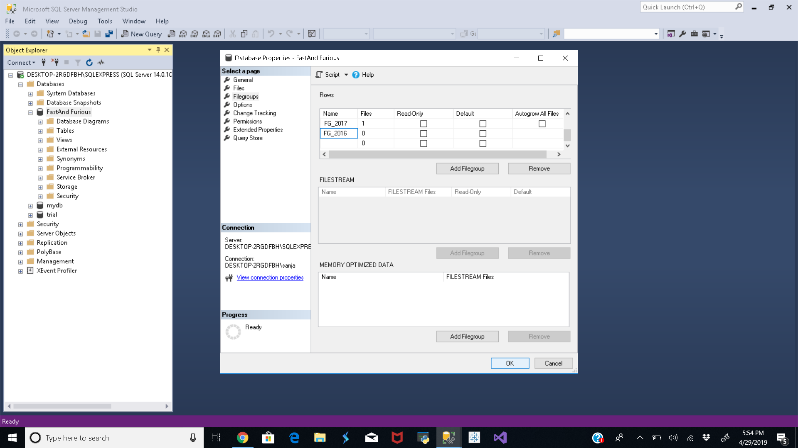
IMPLEMENTATION OF PARTITIONING

Slide 29

IMPLEMENTATION OF PARTITIONING

Slide 30
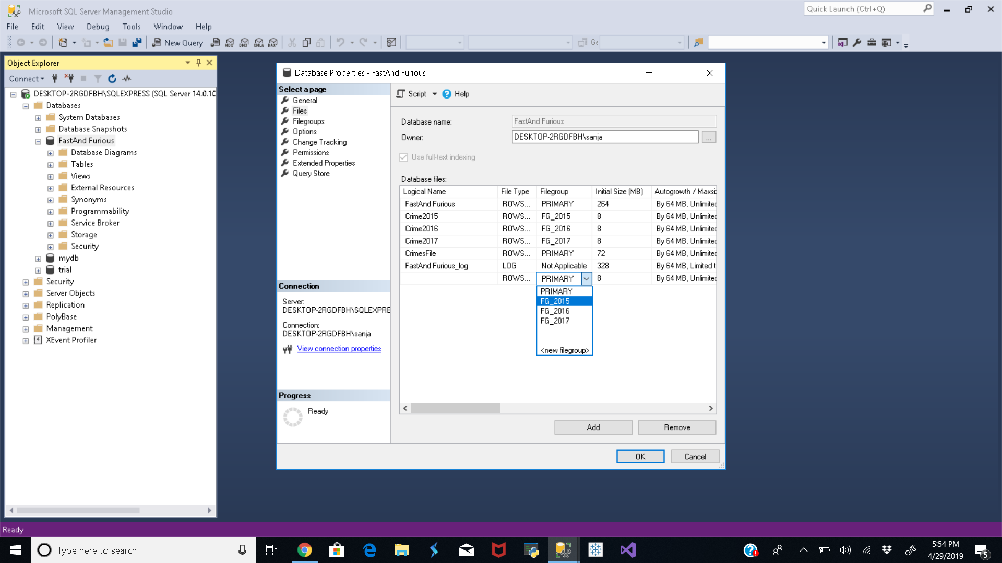
IMPLEMENTATION OF PARTITIONING

Slide 31
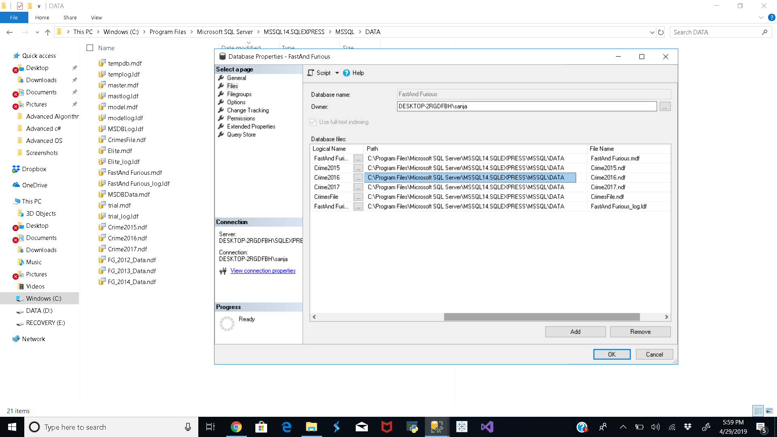
IMPLEMENTATION OF PARTITIONING

Slide 32
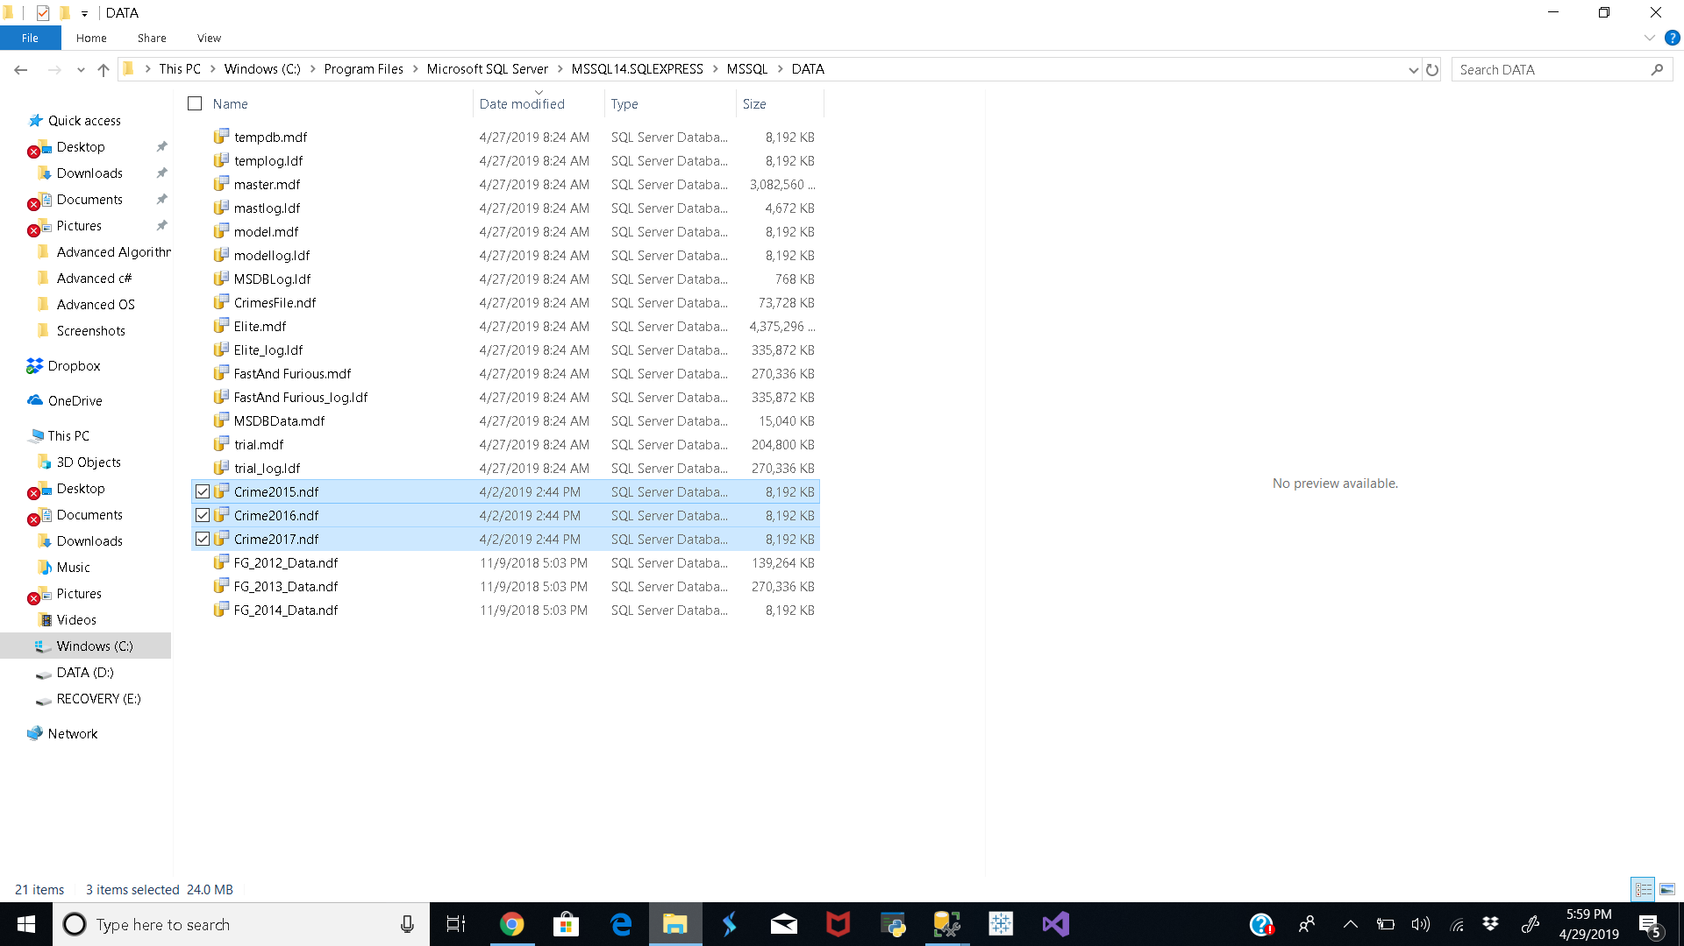
IMPLEMENTATION OF PARTITIONING

Slide 33
IMPLEMENTATION OF PARTITIONING
PARTITIONING ON CRIME:
CREATE PARTITION FUNCTION [_PF_CRIME_YEAR_](varchar(50)) AS RANGE LEFT FOR VALUES (N'2016', N'2017', N'2018')
CREATE PARTITION SCHEME [_PF_CRIME_YEAR_] AS PARTITION [PF_CRIME_YEAR_]
TO ([FG_2015], [FG_2016], [FG_2017], [PRIMARY])

Slide 34
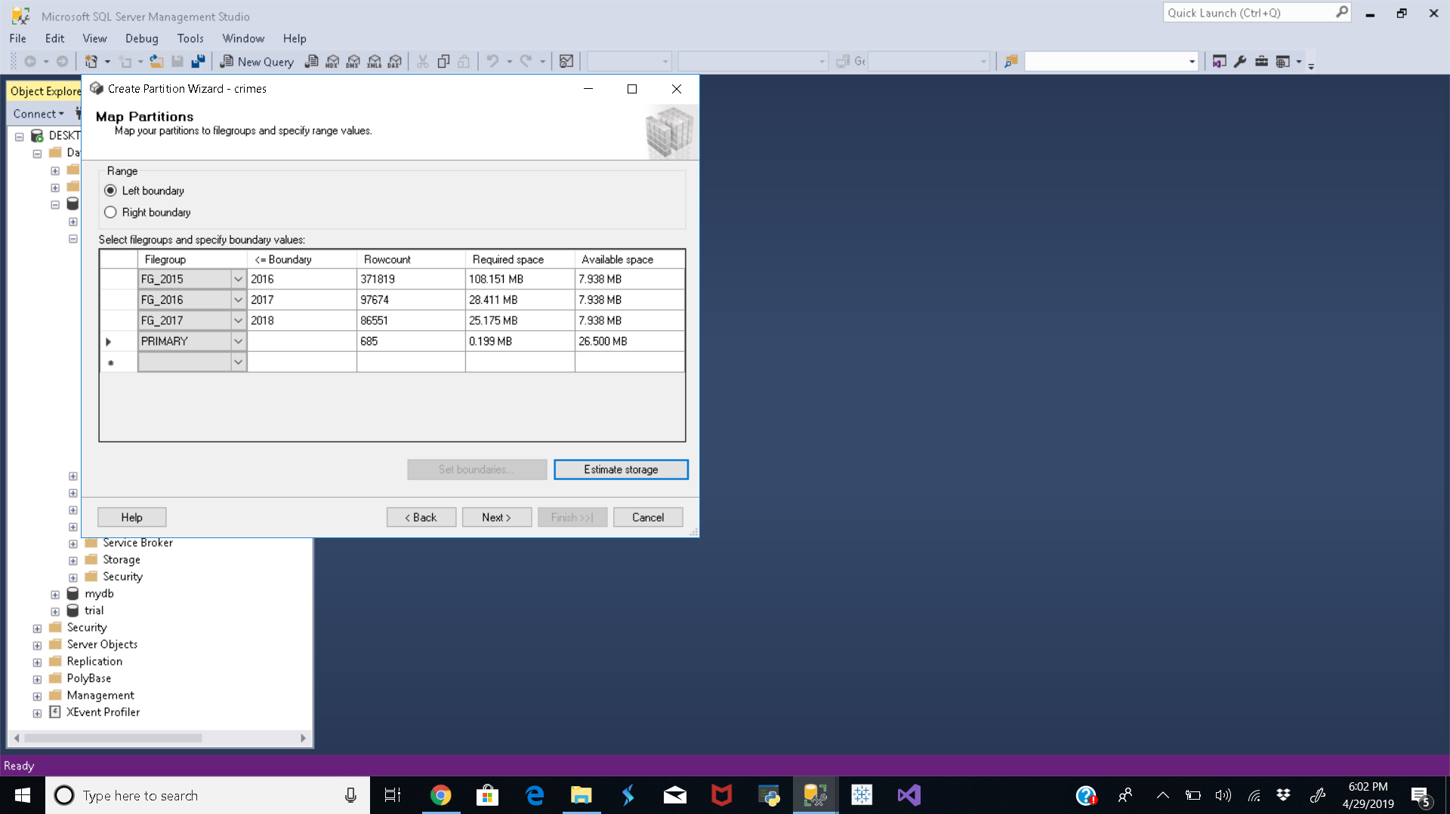
IMPLEMENTATION OF PARTITIONING

Slide 35
IMPLEMENTATION OF PARTITIONING
CREATE TABLE [dbo].[crime2](
[_CRIME_YEAR_][varchar](50) NOT NULL,
[_INCIDENT_ID_] [nvarchar](50) NOT NULL,
[_OFFENSE_ID_] [nvarchar](50) NOT NULL,
[_OFFENSE_CODE_] [nvarchar](50) NOT NULL,
[_OFFENSE_CODE_EXTENSION_] [nvarchar](50)
NOT NULL,
[_OFFENSE_TYPE_ID_] [nvarchar](50) NOT NULL,
[_OFFENSE_CATEGORY_ID_] [nvarchar](50) NOT NULL,
[_FIRST_OCCURRENCE_DATE_] [nvarchar](50) NOT NULL,
[_LAST_OCCURRENCE_DATE_] [nvarchar](50) NOT NULL,
[_REPORTED_DATE_] [nvarchar](50) NOT NULL,
[_INCIDENT_ADDRESS_] [nvarchar](50) NOT NULL,
[_GEO_X_] [nvarchar](50) NOT NULL,
[_GEO_Y_] [nvarchar](50) NOT NULL,
[_GEO_LON_] [nvarchar](50) NOT NULL,
[_GEO_LAT_] [nvarchar](50) NOT NULL,
[_DISTRICT_ID_] [nvarchar](50) NOT NULL,
[_PRECINCT_ID_] [nvarchar](50) NOT NULL,
[_NEIGHBORHOOD_ID_] [nvarchar](50) NOT NULL,
[_IS_CRIME_] [nvarchar](50) NOT NULL,
[_IS_TRAFFIC_] [nvarchar](50) NOT NULL)
ON PS_CRIME_YEAR_(_CRIME_YEAR_)
GO
USE [denver_crime]
GO

Slide 36
Scenario2
List offense which are done on roads but not in the year 2015.
SELECT o. [OFFENSE_CODE] ,o.[OFFENSE_CATEGORY_ID], o.[OFFENSE_CATEGORY_NAME],
o.[IS_CRIME], o.[IS_TRAFFIC]
FROM [FastAnd Furious].[dbo].[offense_codes] o
INNER JOIN [FastAnd Furious].[dbo].[crimes]c ON o.OFFENSE_TYPE_ID=c.OFFENSE_TYPE_ID
WHERE o.OFFENSE_TYPE_NAME like '%vehicl%' and c.crimeyear!='2015'

Slide 37
Scenario3:
List all incidents in year 2016 not related to Drug-Alcohol category or murder
SELECT C.INCIDENT_ID, C.IS_CRIME,O.OFFENSE_CATEGORY_NAME
FROM [FastAnd Furious].[dbo].[crimes] c
JOIN [FastAnd Furious].[dbo].[offense_codes] o
ON o.[OFFENSE_TYPE_ID]= c.OFFENSE_TYPE_ID
AND C.OFFENSE_CATEGORY_ID='drug-alcohol' or C.OFFENSE_CATEGORY_ID like '%murd%' AND C.CRIMEYEAR='2016'

Slide 38
Scenario 4:
List offence codes which are even numbers and give the details of ID and name of the offense
SELECT o.[OFFENSE_TYPE_ID], o.OFFENSE_TYPE_NAME, o.OFFENSE_CODE
FROM [dbo].[offense_codes2] o
JOIN [dbo].[crime2] c ON c.OFFENSE_CATEGORY_ID = o.OFFENSE_CATEGORY_ID
WHERE o.OFFENSE_CODE IN (SELECT o.OFFENSE_CODE
FROM [dbo].[offense_codes2]
WHERE o._OFFENSE_CODE%2 = 0)

Slide 39
IMPLEMENTATION OF PARTITIONING
PARTITIONING ON OFFENSE_CODES :
CREATE PARTITION FUNCTION [PF_Offense_Code](nvarchar(50)) AS RANGE LEFT FOR VALUES (N'2500', N'5000', N'7500', N'10000')
CREATE PARTITION SCHEME [PS_Offense_Code] AS PARTITION [PF_Offense_Code] TO ([FG_2500], [FG_5000], [FG_7500], [FG_10000], [PRIMARY])

Slide 40
IMPLEMENTATION OF PARTITIONING
CREATE TABLE [dbo].[offense_codes2](
[_OFFENSE_CODE_] [nvarchar](50) NOT NULL,
[_OFFENSE_CODE_EXTENSION_] [nvarchar](50) NOT NULL,
[_OFFENSE_TYPE_ID_] [nvarchar](50) NOT NULL,
[_OFFENSE_TYPE_NAME_] [nvarchar](100) NOT NULL,
[_OFFENSE_CATEGORY_ID_] [nvarchar](50) NOT NULL,
[_OFFENSE_CATEGORY_NAME_] [nvarchar](50) NOT NULL,
[_IS_CRIME_] [nvarchar](50) NOT NULL,
[_IS_TRAFFIC_] [nvarchar](50) NOT NULL
)
ON PS_OccurenceDate(_OFFENSE_CODE_)
GO
USE [denver_crime]
GO

Slide 41
COMPARISON OF PARTITIONING SCENARIOS
Time comparison | Without Partitioning | With partitioning
Query1 | 576ms | 44ms
Query2 | 1.08s | 32ms
Query3 | 1.22s | 29ms
Query4 | 1.5s | 65ms

Slide 42
THANK YOU

